Slide 1
VISUAL SERVO CONTROL
Robotics Planning and Navigation

Slide 2
What is Visual Servo?
Visual servo (VS) control refers to the use of computer vision data to control the motion of a robot.
Vision data can we acquired from:
Camera mounted on a manipulator.
Camera fixed in a scene.
In this lecture we will focus primarily on the former, so-called eye-in-hand case.
Notes:
We use information acquired by vision sensors (cameras) for feedback control of the pose/motion of a robot (or of parts of it).
Vision data:
motion of the robot induces camera motion
can observe the robot motion from a stationary configuration.

Slide 3
Basic Components
The aim of all visual servo algorithms is to minimize error e(t) defined by
m(t) - image measurements
a - additional camera information.
s(m(t); a) – visual features
s* - the desired values of the features
e(t) = s(m(t), a) – s*

Slide 4
Classification of Visual Servo
IBVS (Image-based visual servoing)
Error is computed directly on the values of the features extracted on the 2D image plane, without going through a 3D reconstruction.
s consists of a set of features that are immediately available in the image
PBVS (Position-based visual servoing)
Information extracted from images (features) is used to reconstruct the current 3D pose (pose/orientation) of an object.
s consists of a pose, which must be estimated from image measurements.
Notes:
IBVS: the robot should move so as to bring the current image features (what it “sees” with the camera) to their desired values.
PBVS: combined with the knowledge of a desired 3D pose, we generate a Cartesian pose error signal that drives the robot to the goal
Once s is selected, we need to design a design a velocity controller
To do this, we require the relationship between the time variation of s and the camera velocity.

Slide 5
Velocity Controller
v_{c} = (v_{c}, w_{c}) - the spatial velocity of the camera.
s’ - time variation of the features.
L_{s} - Interaction Matrix
s’ = L_{s}v_{c}
Notes:
v_{c} - is the instantaneous linear velocity of the origin of the camera frame
w_{c} - is the instantaneous angular velocity of the camera frame.

Slide 6
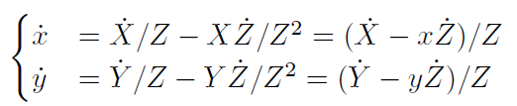
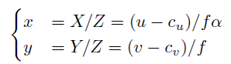
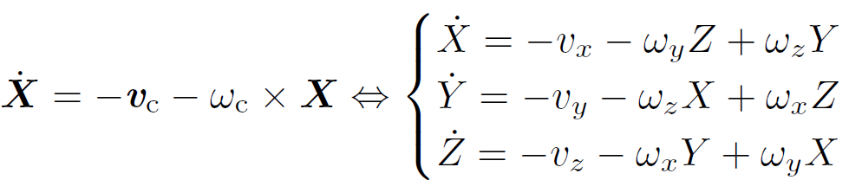
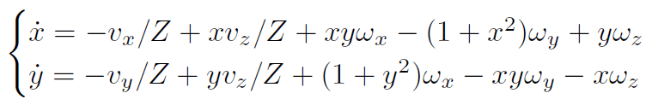
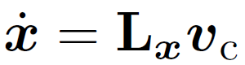
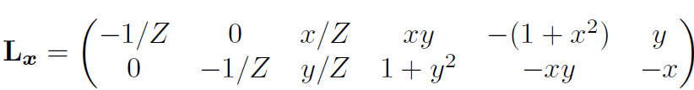
Interaction Matrix calculation (IBVS)
Projection of 3D world-point to image plane with normalized coordinates:
eq.1
X = (X; Y; Z) – 3D world point,
x = (x; y) – normalized image coordinates
(u, v) - coordinates of the image point expressed in pixel units
(c_{u,} c_{v}) - coordinates of the principal point,
f - focal length
α - ratio of the pixel dimensions.
Camera velocity: v_{c} = (v_{x}; v_{y}; v_{z}) and w_{c} = (w_{x}, w_{y},w_{z}).
Taking derivative of the projection equation:
eq.2
We can relate the velocity of the 3-D point to the camera spatial velocity using the well-known equation:
eq.3
Inserting eq.3 into eq.2, and grouping terms.
Which can be written as:

Slide 7
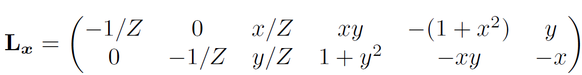
Interaction Matrix calculation (IBVS)
In the matrix L_{x}, the value Z is the depth of the point relative to the camera frame. Therefore, any control scheme that uses this form of the interaction matrix must estimate or approximate the value of Z.
Similarly, the camera intrinsic parameters are involved in the computation of x and y.

Slide 8
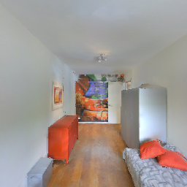

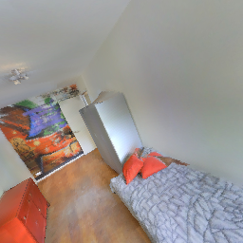
Example of IBVS
Initial Image
Target Image

